Slide 1
Medical Chatbot with Report Analysis
Student Details: E Dinesh Godwin-2160334
Aleeza Alex - 2160417
Anju E George - 2160425
Guided By: Prof Chaitra PC

Slide 2
Agenda
Abstract
Problem Statement and Objectives
Literature Review/ Background Study
Hardware and Software Requirements
Design and Framework
Implementation Details
Results and Discussions
Conclusion and Future scope
Learning Outcomes
References

Slide 3
Abstract
The healthcare industry is continually evolving with the integration of advanced technologies to enhance patient care and streamline medical processes.
This project aims to develop a Medical Chatbot with Report Analysis, leveraging LLAMA 2 model to provide users with accurate medical information, personalized recommendations, and comprehensive analysis of uploaded medical reports.
The chatbot will assist both medical staff and patients by answering queries, interpreting medical reports, and suggesting necessary actions, thereby improving the efficiency of medical consultations and patient care.
The potential implications of this technology in the healthcare sector include improved patient engagement, reduced workload for healthcare professionals, and enhanced overall healthcare delivery.

Slide 4
Problem Statement
In the current healthcare landscape, accessing accurate medical information and understanding complex medical reports can be challenging for both patients and medical professionals. There is a need for a solution that can provide immediate, reliable answers to medical queries and simplify the interpretation of medical reports, ensuring timely and informed medical decisions.
Objectives:
Create a user friendly interface to enable easy interaction with the chatbot for users.
Develop a chatbot capable of understanding and responding to a wide range of medical queries.
Implement a feature that allows users to upload medical reports for automated analysis and provide personalized recommendations and actionable insights based on the report analysis.

Slide 5
Literature Review / Background Study
Authors | Highlights | Limitations
B. Tamizharasi, Jenila Livingston L.M., S. Rajkumar | Title:Building a Medical Chatbot using Support Vector Machine Learning Algorithm Methodology/Algorithm: Support Vector Machine (SVM) Merits: High accuracy (92.33%). Efficient with large datasets. Utilizes Natural Language Processing (NLP) for effective conversation. | Limited handling of non-linear data without kernel functions. Privacy concerns. Scalability issues with diverse datasets.

Slide 6
Authors | Highlights | Limitations
Basabdatta Sen Bhattacharya , Vibhav Sinai Pissurlenkar. | Title: Assistive Chatbots for healthcare: a succinct review Methodology/Algorithm: Natural Language Processing (NLP)Machine Learning Algorithms Merits: Reduced Dependence on Human Interaction: These Chatbots can save man-hours by reducing the need for human-human interaction. Availability of Commercial Chatbots: There are several commercial Chatbots currently being used for patient support. Advanced Mental Healthcare Chatbots: Mental healthcare Chatbots are at a more advanced stage of development and some have been used in clinical trials. Potential for Personalized Healthcare: The advent of generative AI like ChatGPT offers potential for highly personalized healthcare services. | NLP Skills Dissatisfaction: Patients have expressed dissatisfaction with the Natural Language Processing (NLP) skills of Chatbots compared to human interaction. Current Limitations of ChatGPT: Despite its advanced NLP capabilities, ChatGPT cannot be trusted with patient safety and medical ethics without thorough checks. Requirement for Clinical Trials: Rigorous evaluation through clinical trials is essential to establish the reliability of Chatbots in terms of patient safety and data protection.

Slide 7
Authors | Highlights | Limitations
Elia Grassini, Marina Buzzi, Barbara Leporini, Alina Vozna. | Title:A systematic review of chatbots in inclusive healthcare: insights from the last 5 years Methodology/Algorithm: Rule-based chatbots, Convolutional Neural Networks (CNN), Long Short-Term Memory (LSTM), Feed-forward neural networks. Merits: Efficiency: Chatbots can enhance user interaction by providing quick feedback or responses. Cost Reduction: They can decrease medical and organizational burden while cutting costs. User Assistance: They provide user assistance, such as consultations, diagnosis, and psychological support. Information Gathering: Chatbots gather patient information and symptoms, enhancing response accuracy and service improvement. | Design Issues: Many chatbots do not consider interface design, especially for users with special needs. Accessibility: Limited attention to accessibility and inclusive design. Miscommunication: Potential for miscommunication between chatbots and users. Voice Interaction Challenges: Chatbots based on voice interaction sometimes fail to provide short, simple answers and feedback.

Slide 8
Authors | Highlights | Limitations
Lekha Athota, Vinod Kumar Shukla, Ajay Rana. | Title:Chatbot for Healthcare System Using Artificial Intelligence Methodology/Algorithm: N-gram, TF-IDF for extracting the keyword. Merits: The chatbot stores data in a database to identify sentence keywords and make query decisions. The system functions as a standalone application with user interfaces to interact with the chatbot. The expert system steps in to handle complex questions and queries beyond the chatbot's pre-stored knowledge base. | Dependency on Pre-stored Knowledge Base: The chatbot can only provide answers to queries that are already present in its database. Handling of Unknown Queries: Questions not present in the database require intervention by an expert system, indicating a lack of complete autonomy. Text-based System: The system is limited to text-based interactions and does not support voice recognition capabilities. Limited to Basic Details: The chatbot provides basic details and initial diagnosis, but complex medical queries and detailed consultations still require a healthcare professional. Potential Gaps in Database: There may be potential gaps in the knowledge base, especially for new or rare medical conditions, limiting the chatbot's effectiveness

Slide 9
Authors | Highlights | Limitations
Mrs. Rashmi Dharwadkar , Dr.Mrs. Neeta A. Deshpande | Title:A Medical ChatBot Methodology/Algorithm: Natural Language Processing (NLP), Support Vector Machine (SVM). Merits: Immediate Response: Users receive instant answers to their health-related queries. Accessibility: Users can access medical advice without visiting a hospital. Convenience: Reduces the burden on healthcare providers by handling routine queries. Disease Prediction: Can predict diseases based on common symptoms, aiding in early diagnosis. | Limited Accuracy: The system's accuracy depends on the quality and size of the training data. Complexity of Human Language: Understanding and accurately processing natural language can be challenging. Dependency on APIs: Reliance on external APIs for voice-text conversion may introduce latency or errors.

Slide 10
Hardware and Software Requirements
Hardware:
User Devices: Smartphones, tablets, and computers for accessing the chatbot application.
Software:
Frontend:
Front end: HTML, CSS
Backend:
Frameworks: Flask for the server-side application.
Database: Pinecone(Vector Database)
Model : Llama 2.

Slide 11
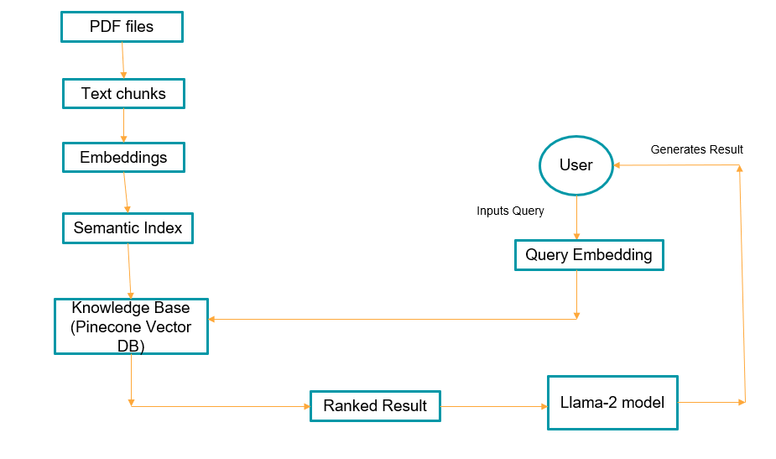
Design and Framework

Slide 12
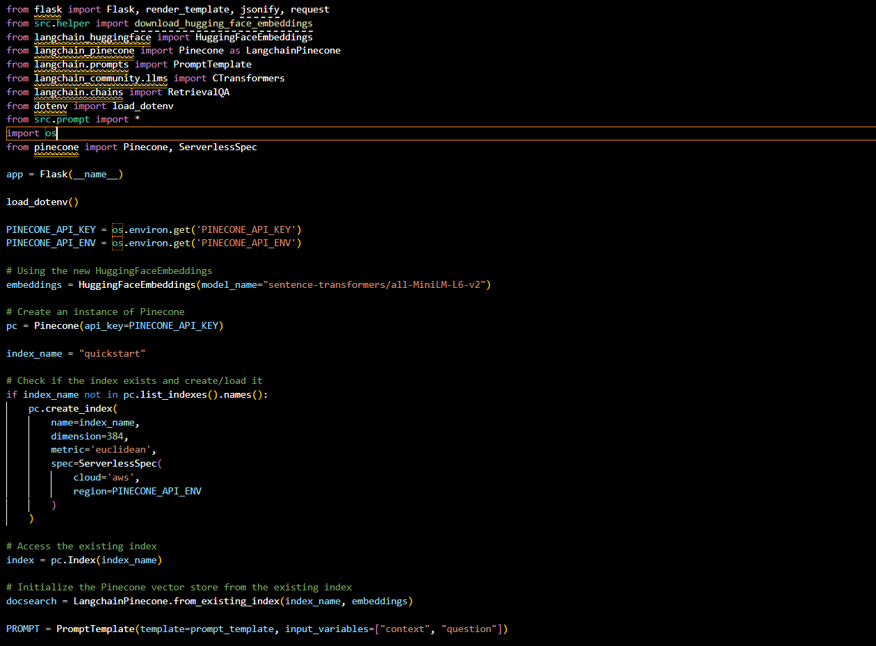
Implementation Details

Slide 13
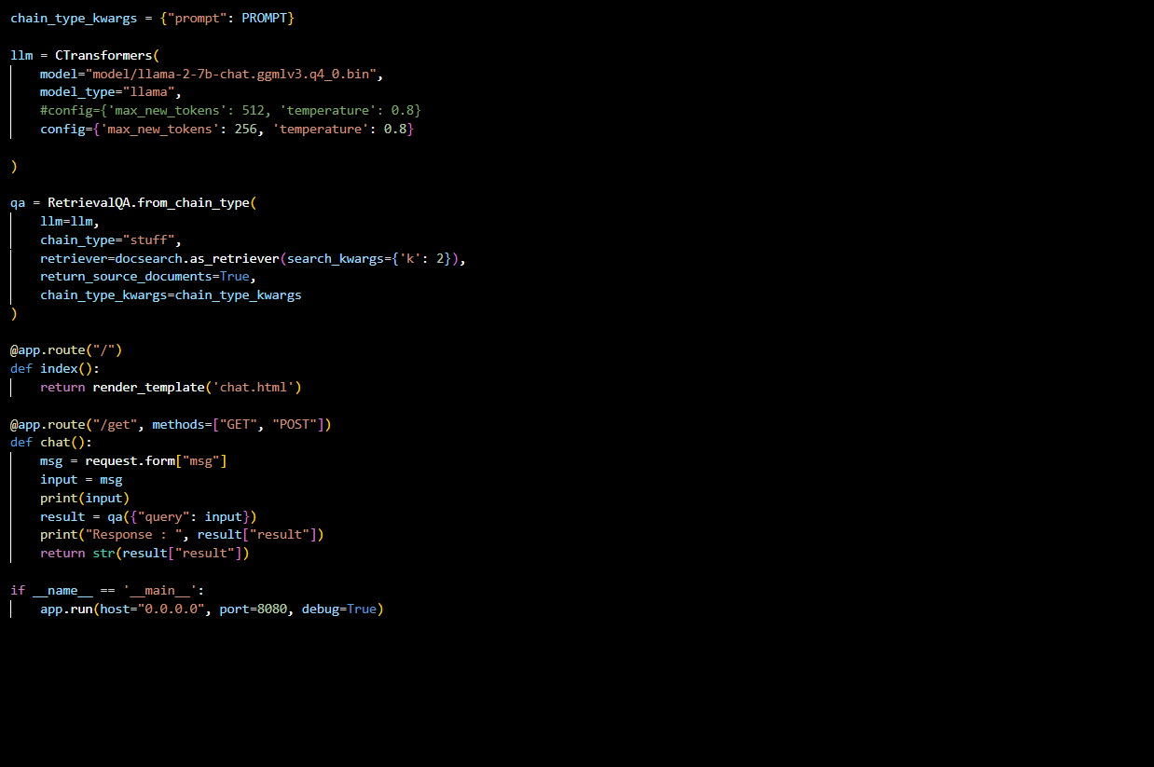
Implementation Details

Slide 14
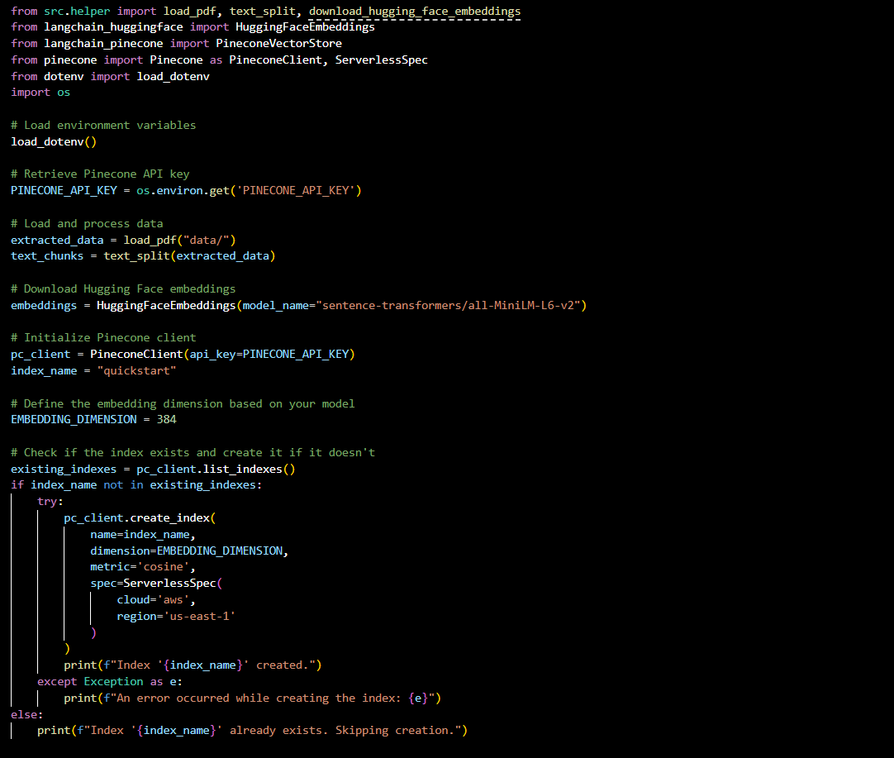
Implementation Details

Slide 15
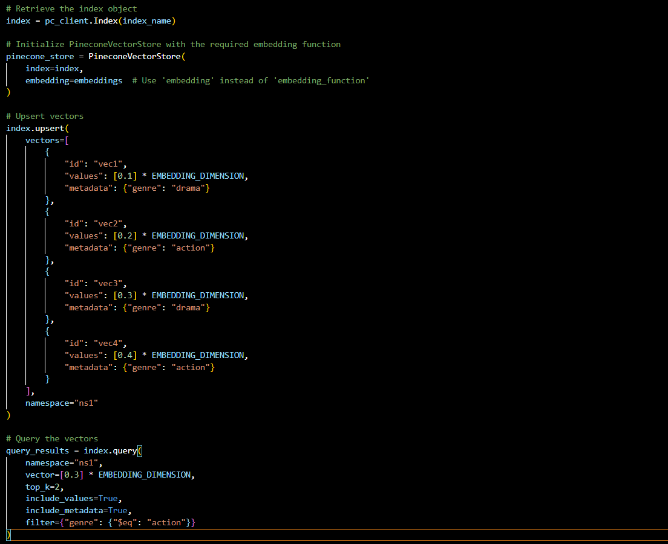
Implementation Details

Slide 16
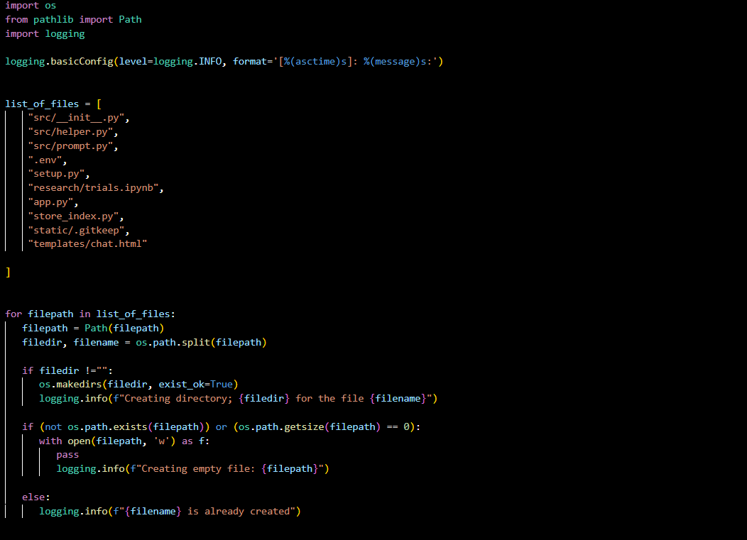
Implementation Details

Slide 17
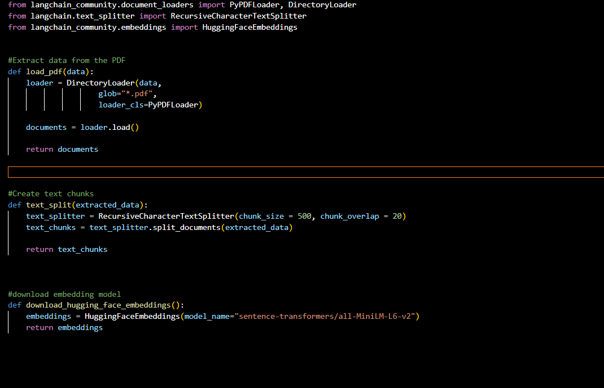
Implementation Details

Slide 18
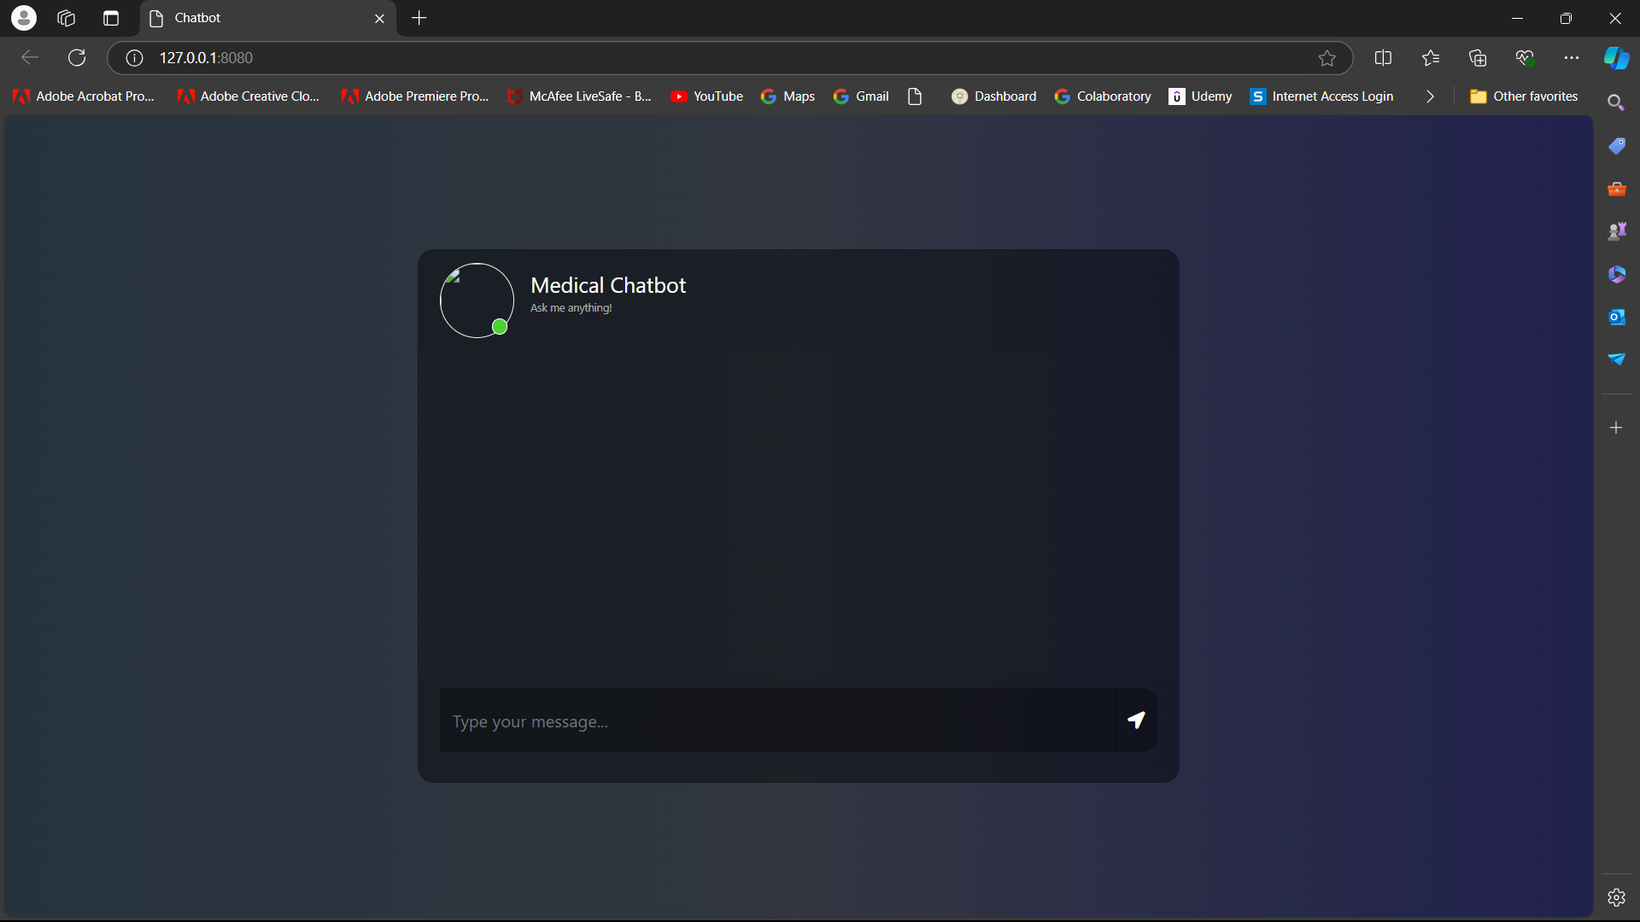
Results and Discussion

Slide 19
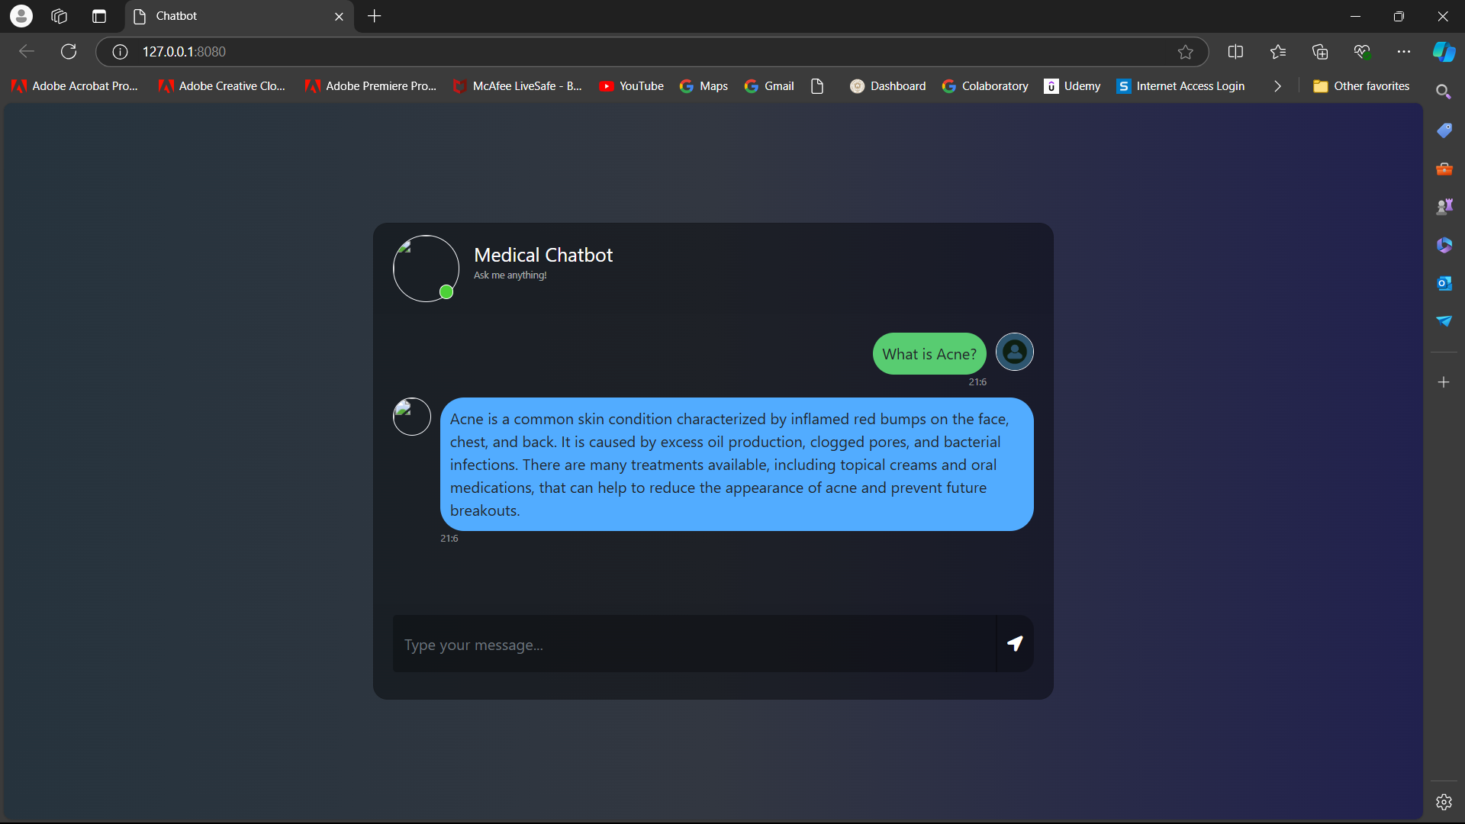
Results and Discussion

Slide 20
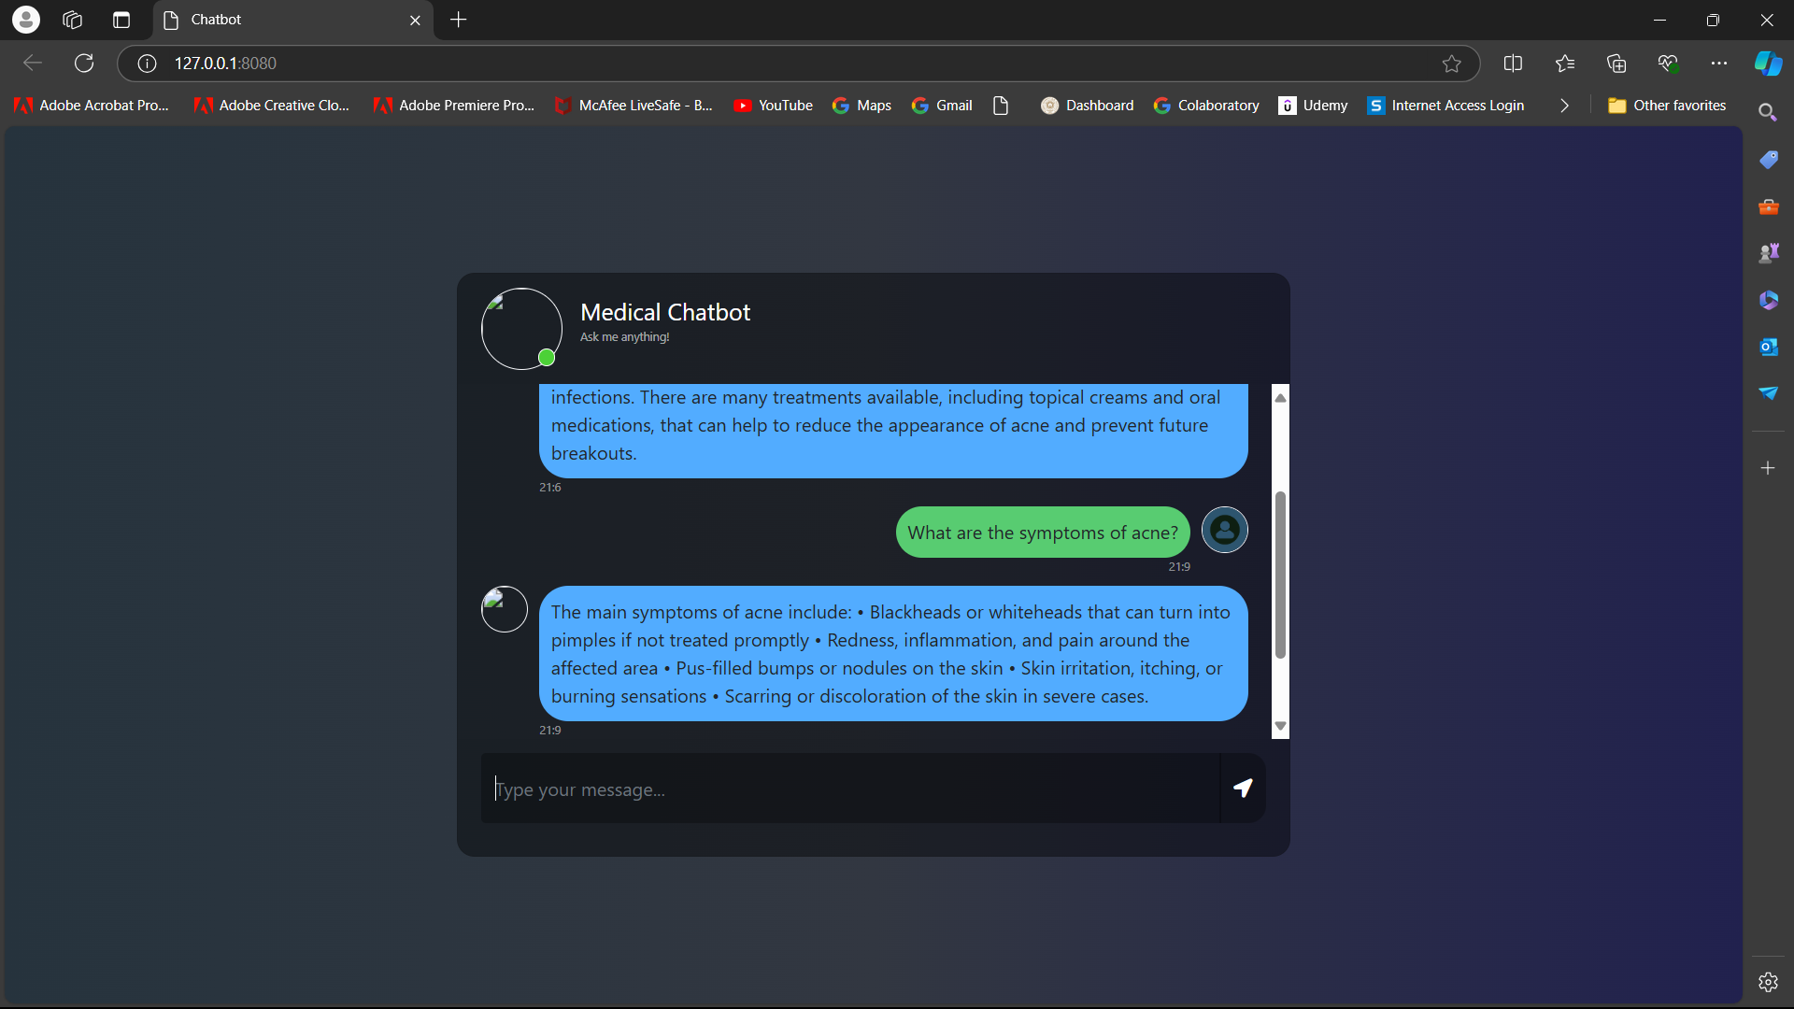
Results and Discussion

Slide 21
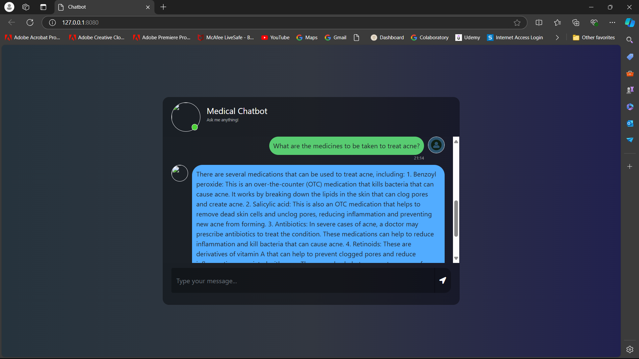
Results and Discussion

Slide 22
Conclusion
Two major objectives were successfully accomplished:
User-Friendly Interface: The development of a seamless, intuitive interface ensures that users can easily interact with the chatbot. This allows them to submit medical queries and receive answers in real time, while also offering the ability to upload medical reports for future analysis.
Medical Query Understanding: The chatbot demonstrates a strong ability to understand and respond to a wide variety of medical queries. Through the use of semantic indexing and nearest-neighbor search, it provides answers that are both relevant and precise, enhancing the user experience.

Slide 23
Future Scope
Expansion of Medical Knowledge: To further improve its capabilities, the chatbot's knowledge base can be regularly updated with new medical research, ensuring that it remains current with advancements in the healthcare domain. Integrating real-time research and up-to-date medical guidelines would further improve response accuracy.
Enhanced Conversational Abilities: Another future enhancement involves improving the chatbot's conversational flow, allowing it to handle more complex medical interactions. By incorporating advanced dialogue systems, it can engage in multi-turn conversations, thus improving user satisfaction and creating a more natural interaction experience.
Support for Multilingual Queries: Expanding the chatbot's language capabilities to support multiple languages would make it more accessible to non-English speakers. Incorporating multilingual NLP models could increase its reach and usability across diverse populations.

Slide 24
Learning Outcomes
Gain a deep understanding of transformer architecture like LLAMA2.
Learn how to use vector databases like pinecone for storing and querying text embeddings.
Web Development.

Slide 25
References
1. B. Tamizharasi, L. M. Jenila Livingston, and S. Rajkumar, “Building a Medical Chatbot using Support Vector Machine Learning Algorithm,” Journal of Physics: Conference Series, vol. 1716, p. 012059, Dec. 2020, doi: https://doi.org/10.1088/1742-6596/1716/1/012059.
2. Sen Bhattacharya, B. & Vibhav Sinai Pissurlenkar. (2023). Assistive Chatbots for healthcare: a succinct review (pp. 1–27) [Journal-article]. https://ar5iv.labs.arxiv.org/html/2308.04178
3. Grassini, E., Buzzi, M., Leporini, B., & Vozna, A. (2024). A systematic review of chatbots in inclusive healthcare: insights from the last 5 years. Universal Access in the Information Society. https://doi.org/10.1007/s10209-024-01118-x
4. Xu, L., Sanders, L., Li, K., & Chow, J. C. L. (2021). Chatbot for health care and oncology applications using Artificial Intelligence and Machine Learning: Systematic review. JMIR Cancer, 7(4), e27850. https://doi.org/10.2196/27850
5. Athota, L., Shukla, V. K., Pandey, N., & Rana, A. (2020). Chatbot for Healthcare System Using Artificial Intelligence. Chatbot for Healthcare System Using Artificial Intelligence. https://doi.org/10.1109/icrito48877.2020.9197833

